Slide 1

Digital Innovation
2020 CC FS Digital Innovation Personal Review
[Vaibhav Mehta]
[Senior Engineer]
Location: Monroe NJ

Slide 2
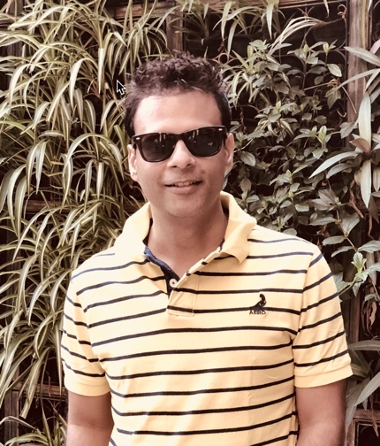


Vaibhav Mehta
Senior Engineer
Role & Responsibilities
Senior Engineer
I take care of MLB Storage & Back up
I take care of Implementation Projects
Background
EMC Storage and back up Specialist
SME- Avamar, EMC Storage
2 year with EMC Boston MA
Total 10 years with Fusionstorm-Computacenter
Technical Architect for SunGard ( ESR4EMC Multitenancy)
System Admin for Well know Bank India
Vaibhav.Mehta@Computacenter.com
Personal
I love listening Reading & Discussing Motivational & Spiritual Books
I am good at cooking food
I am good at astrology
+001 732 799 8114
@vb_mehta
© Computacenter 2020

Slide 3



Crawl, Walk, Run
Your Personal Capability Narrative
Capability
Capability
MLB Expert services project at steady state.
AWS LABs
MLB
A Cloud Guru
Capability
Capability
Walk - AWS Certification
AWS SAA
AWS Developer Associate
AWS Sysops Associate
AWS Solutions Architect
Kick off Devops project
AWS Certification all associate level
Capability
Crawl – Devops and Coding
Get Deeper knowledge and understanding on some other tools available for Automation
Capability
Devops
Python Coding

Slide 4
Biggest Failure or Success in 2019
Failure
Success
I have not failed; I have just found 10000 ways that wont work – Thomas Edison
Brief Description | Determining Factor | F | S
AWS Certification Test MLB /Corner Stone / Weho | Exam Successfully completed and steady state | S F S
What
How
Why
I am Successful Failure
Failed Certification Test
Followed “24 hours rule” for my failure
But Learned and gained so much Knowledge on AWS
I feel Successful for my achievement for all the projects I completed successfully
I was successful in getting MLB at a stable state of course with help of team member.
I must be reading from exam point of view (AWS)
Success-
Long hours of working
Proactive
Set Goals
Willingness to help customer and make them feel secured
I need to go through more documentation, white papers and Practical Labs
Notes:
“Failure is simply the opportunity to begin again, this time more intelligently.” – Henry Ford
Explain 24-hour rule - a policy of looking forward instead of dwelling on the past.
I feel my emotions of success or failure as deeply as they could.
The next day, it’s time to put it behind them and focus our energy on preparing for their next challenge

Slide 5
2019 Personal Goal Review
Whiffed
Kind of
Nailed it
“Discipline is the bridge between goals and accomplishment.” – Jim Rohn
# | GOAL | UPDATE | STATUS
1 | Get comfortable with expert service process ( I am almost there ) |  | Nailed it
2 | Complete all AWS Certification |  | Whiffed
3 | Technical Project management | Didn’t get opportunity to work | Blah, Blah, Blah
4 | If get an opportunity to perform or shadow any cloud project | Didn’t get opportunity to work | Blah, Blah, Blah
5 | Start investing in Stock in NYSE | Set up account an, started working on it | Kind of

Slide 6
Buy, Sell, Hold
“Choices are the hinges of destiny.” - Edwin Markham
Buy
Sell
Hold
Join 5 AM club ( Already in)
Be Bold and take Risks
Health
Devops
Python Coding
Work on AWS Project
Get out of comfort zone
Afraid of change
Stop pleasing every one
Health ( Yoga )
Read More Books
Start Investing in Stocks
Proud member of 5 AM club
Amazing at customer relationship
Notes:
Knowledge is power but execution is potential power

Slide 7
2020 Personal Goals
“If you want to be happy, set a goal that commands your thoughts, liberates your energy and inspires your hopes.” - Andrew Carnegie
$$
Plan for financial Freedom
##
Be more health conscious
AWS
Cloud
Dev
Achieve AWS Cert.
Get Better at AWS cloud
Polish DevOps Skills

Slide 8

Thank You
Contact Me
Name –Vaibhav Mehta Title – Senior Engineer Vaibhav,Mehta@computacenter.com Cell: (732) 799-8114 @vb_mehta

